Slide 1
Chapter 3-3
Sequential Logic Circuits
计算机系统概论
Introduction to Computing Systems
（CS1002A.02）
苗付友
mfy@ustc.edu.cn
2023 Fall
计算机科学与技术学院
School of Computer Science and Technology

Slide 2
Outline
1
Review
2
Sequential Logic Circuits
3
From Logic to Data Path
4
Summary

Slide 3
Outline
1
Review
2
Sequential Logic Circuits
3
From Logic to Data Path
4
Summary

Slide 4
Review
We’ve touched on basic digital logic
  Transistors
  Gates
  Storage (latches, flip-flops, register, memory)
Built some simple logical circuits
  adder, subtracter, adder/subtracter，Incrementer
  Counter (consisting of register and incrementer)

Slide 5
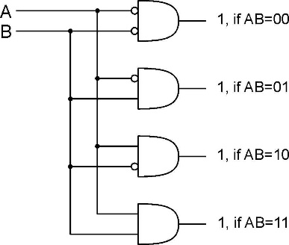
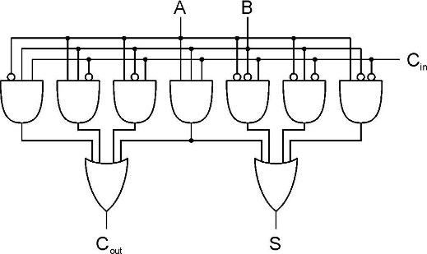
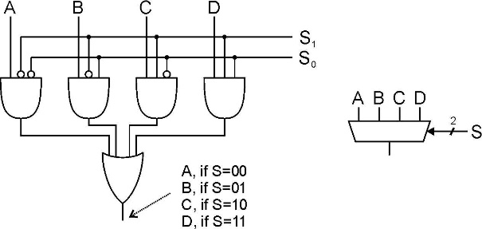
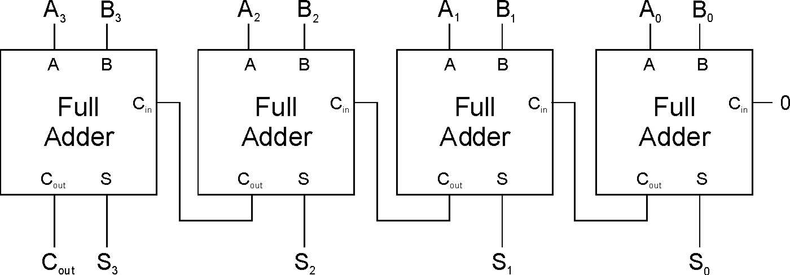
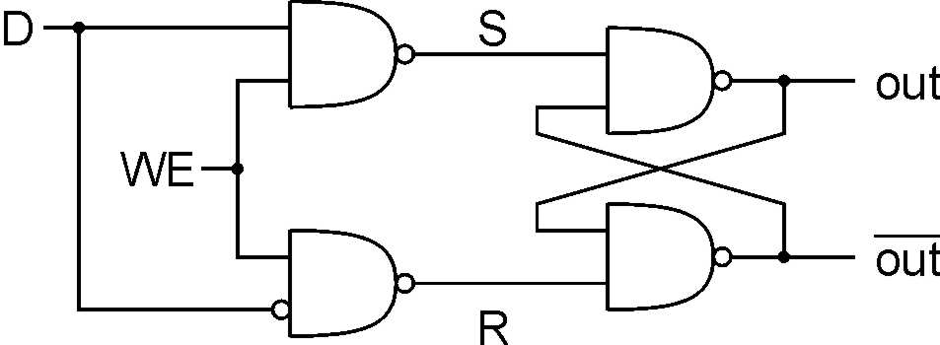
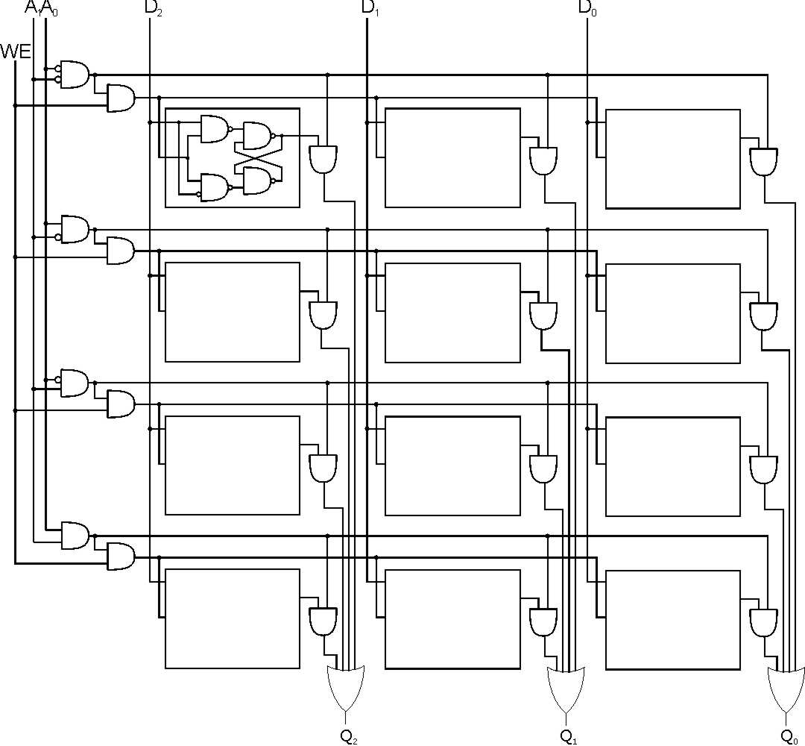
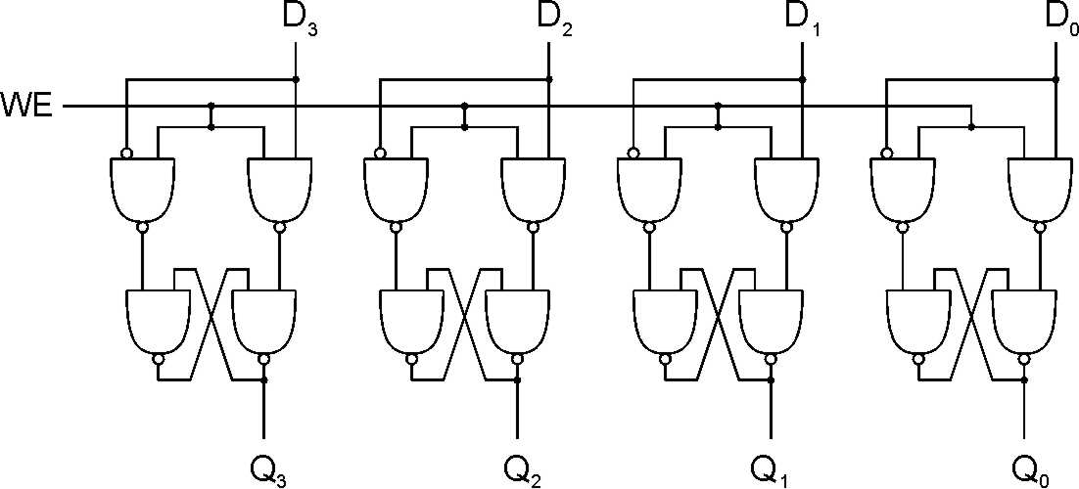
Basic Logical Structure

Slide 6
Today
A computer as a (simple?) state machine
  State machines
  Programmable traffic sign state machine

Slide 7
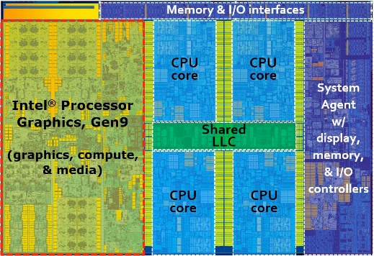

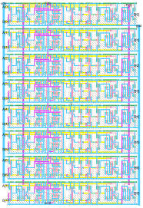
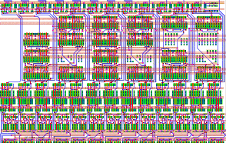
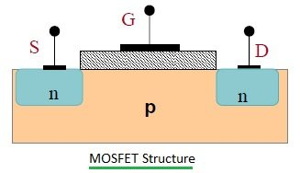
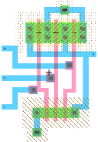
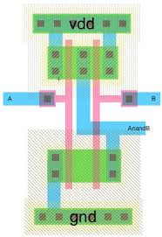
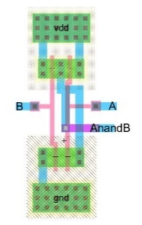
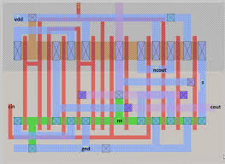
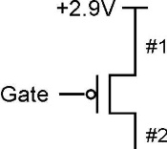
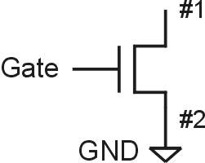
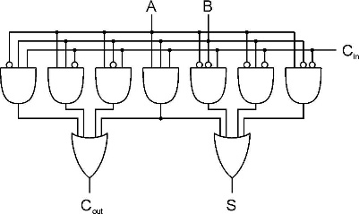
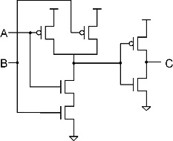
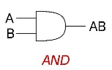

Approach: Bottom Up
Now, You are Here.
ALU
Full Adder
_{Integrated Circuit Design}
_{100 Modules/ IC}
_{0.25M~20G Devices}
Register Transfer Level (RTL) Design
_{1K~10K Cells/Module}
_{(100K Devices)}
And Here.
A
B
C_{in}
_{Gete Level Design}
_{Transistor Physical Layout}
+
Clk
Register
C_{out}
S
_{Scheme for}
_{Representing Information}
_{Circuit Level Design}
_{（Transistor Level Design）}
_{(2~8 Devices/Gate)}
Register Transfer Level (RTL) Design
_{2~16 Gates/Cell}
_{(16~64 Devices)}

Slide 8
Great Idea #3: Abstraction Helps Us Manage Complexity
Application
Solve a system of equations
Algorithm and Data Structure
Gaussian
elimination
Jacobi
iteration
Programming Language/Compiler
Red-black SOR
Multigrid
Operating System/Virtual Machines
Instruction Set Architecture (ISA)
FORTRAN
C
C++
Java
Microarchitecture
Sun SPARC
Intel x86
IBM PowerPC
Gates/Register-Transfer Level (RTL)
Pentium 4
Core 2 Duo
AMD Athlon X2
Analog/Digital Circuits
Electronic Devices
Ripple-carry adder
Carry-lookahead adder
Physics
Static CMOS
Dynamic CMOS
Nanomechanical

Slide 9
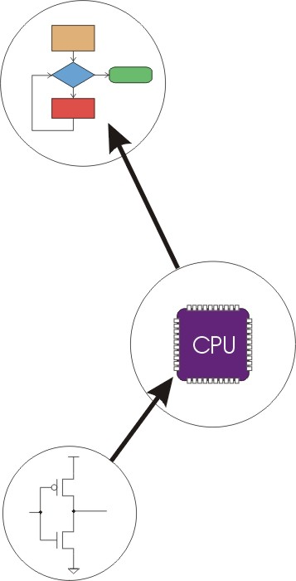
Great Idea #4: Software and Hardware Co-design
Application
Algorithm & Data Structure
Language
Software
Machine Architecture, ISA
Hardware
Microarchiture
Logic and IC
Now, You are Here.
Device
Computer System: Layers of Abstraction
Notes:
9

Slide 10
Outline
1
Review
2
Sequential Logic Circuits
3
From Logic to Data Path
4
Summary

Slide 11
State Machine
State Machine
Inputs
Combinational
Logic Circuit
Outputs
Storage
Elements
Another type of sequential circuit
  Combines combinational logic with storage
  “Remembers” state, and changes output (and state)
  based on inputs and current state

Slide 12
Combinational vs. Sequential
30
4
1
8
4
25
5
20
10
15
Combinational
Success depends only on
the values, not the order in
which they are set.
Sequential
Success depends on
the sequence of values
(e.g, R-13, L-22, R-3).
Two types of “combination” locks

Slide 13
State
The state of a system is a snapshot of all the relevant elements of the system at the moment the snapshot is taken.
Examples:
  The state of a basketball game can be represented by the scoreboard.
    Number of points, time remaining, possession, etc.

Slide 14
State of Sequential Lock
Our lock example has four different states,
labelled A-D:
A: The lock is not open,
and no relevant operations have been performed.
B: The lock is not open,
and the user has completed the R-13 operation.
C: The lock is not open,
and the user has completed R-13, followed by L-22.
D: The lock is open.

Slide 15
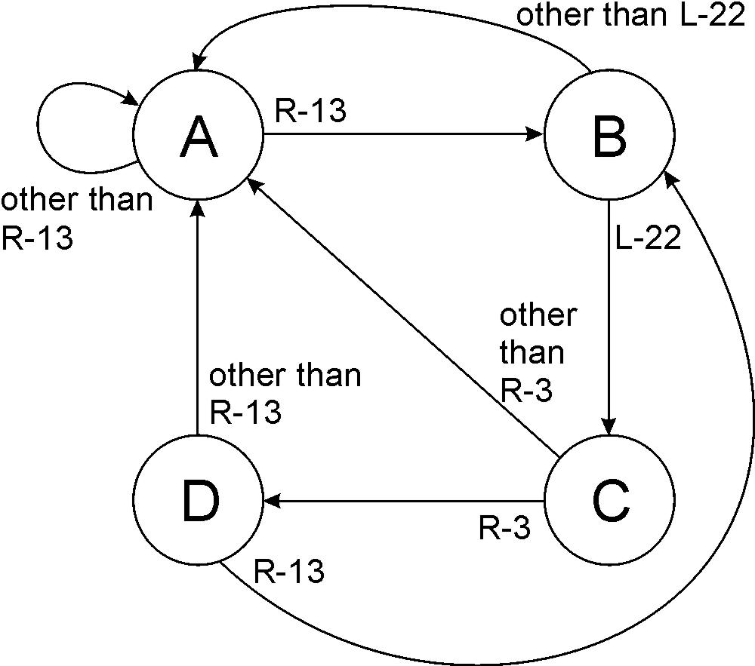
State Diagram
Shows states and actions that cause a transition between states.

Slide 16
Finite State Machine
A description of a system with the following components:
A finite number of states
A finite number of external inputs
A finite number of external outputs
An explicit specification of all state transitions
An explicit specification of what causes each
external output value.
Often described by a state diagram.
  Inputs may cause state transitions.
  Outputs are associated with each state (or with each transition).

Slide 17
Implementing a Finite State Machine
State Machine
Inputs
Combinational
Logic Circuit
Outputs
Storage
Elements
Clock
Combinational logic
  Determine outputs and next state.
Storage elements
  Maintain state representation.

Slide 18
The Clock
“1”
“0”
One
Cycle
time→
Frequently, a clock circuit triggers transition from
one state to the next.
At the beginning of each clock cycle, state machine makes a transition, based on the current state and the external inputs.
  Not always required. In lock example, the input itself triggers a transition.

Slide 19
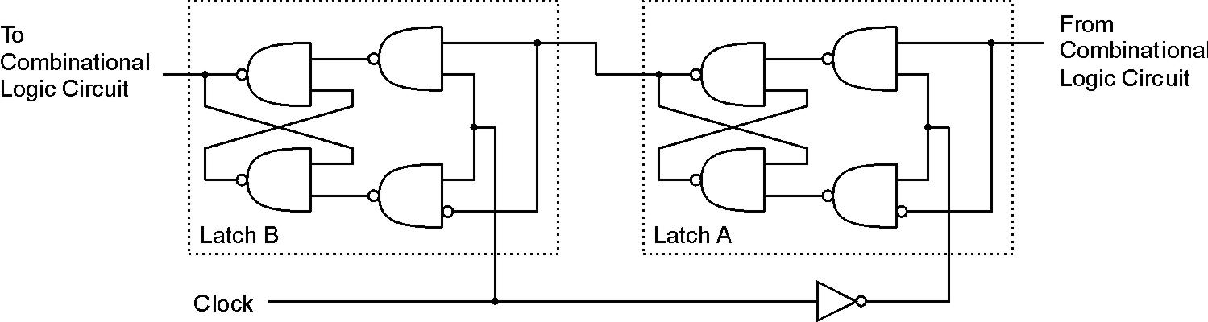
Storage: Master-Slave Flipflop
A pair of gated D-latches,
to isolate next state from current state.
During 1st phase (clock=1),
previously-computed state
becomes current state and is
sent to the logic circuit.
During 2nd phase (clock=0),
next state, computed by
logic circuit, is stored in
Latch A.

Slide 20
Storage: Master-Slave Flipflop

Slide 21
Storage
Each master-slave flip-flop stores one state bit.
The number of storage elements (flip-flops) needed
is determined by the number of states
(and the representation of each state).
Examples:
  Sequential lock
    Four states – two bits
  Basketball scoreboard
    7 bits for each score, 5 bits for minutes, 6 bits for seconds,
    1 bit for possession arrow, 1 bit for half, …

Slide 22
Complete Example
3
4
1
5
2
DANGER
MOVE
RIGHT
A blinking traffic sign
  No lights on
  1 & 2 on
  1, 2, 3, & 4 on
  1, 2, 3, 4, & 5 on
  (repeat as long as switch
  is turned on)

Slide 23
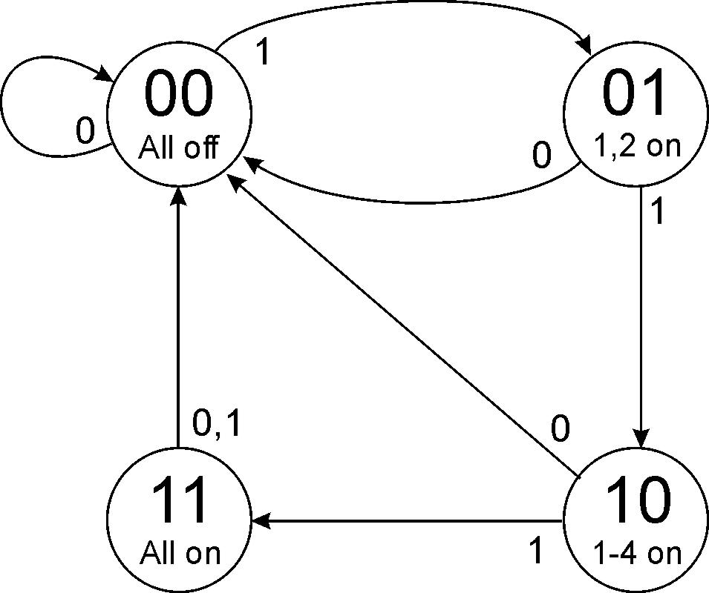
Traffic Sign State Diagram
Switch on
Switch off
State bit S1
State bit S0
Outputs
Transition on each clock cycle.

Slide 24
Traffic Sign State Diagram: State 00
Transition on each clock cycle.

Slide 25
Traffic Sign State Diagram: State 01
Transition on each clock cycle.

Slide 26
Traffic Sign State Diagram: State 10
Transition on each clock cycle.

Slide 27
Traffic Sign State Diagram: State 11
Transition on each clock cycle.

Slide 28
Traffic Sign State Diagram: State 00
Transition on each clock cycle.

Slide 29
Traffic Sign Truth Tables
Outputs
(depend only on state: S1S0)
Next State: S1’S0’
(depend on state and input)
Lights 1 and 2
Switch
Lights 3 and 4
In | S₁ | S₀ | S₁’ | S₀’
0 | X | X | 0 | 0
1 | 0 | 0 | 0 | 1
1 | 0 | 1 | 1 | 0
1 | 1 | 0 | 1 | 1
1 | 1 | 1 | 0 | 0
Light 5
S₁ | S₀ | Z | Y | X
0 | 0 | 0 | 0 | 0
0 | 1 | 1 | 0 | 0
1 | 0 | 1 | 1 | 0
1 | 1 | 1 | 1 | 1
Whenever In=0, next state is 00.

Slide 30
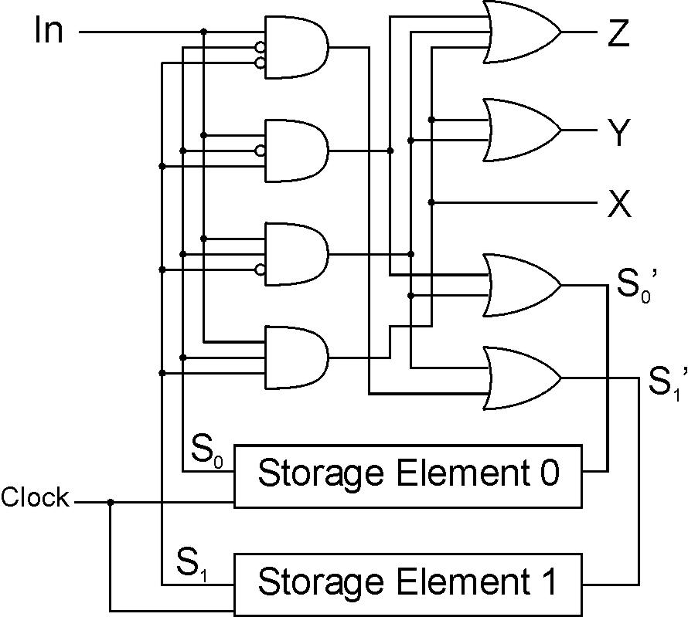
Traffic Sign Logic
S₁ | S₀ | Z | Y | X
0 | 0 | 0 | 0 | 0
0 | 1 | 1 | 0 | 0
1 | 0 | 1 | 1 | 0
1 | 1 | 1 | 1 | 1
S’1
S’0
S1
Master-slave
flipflop
S0

Slide 31
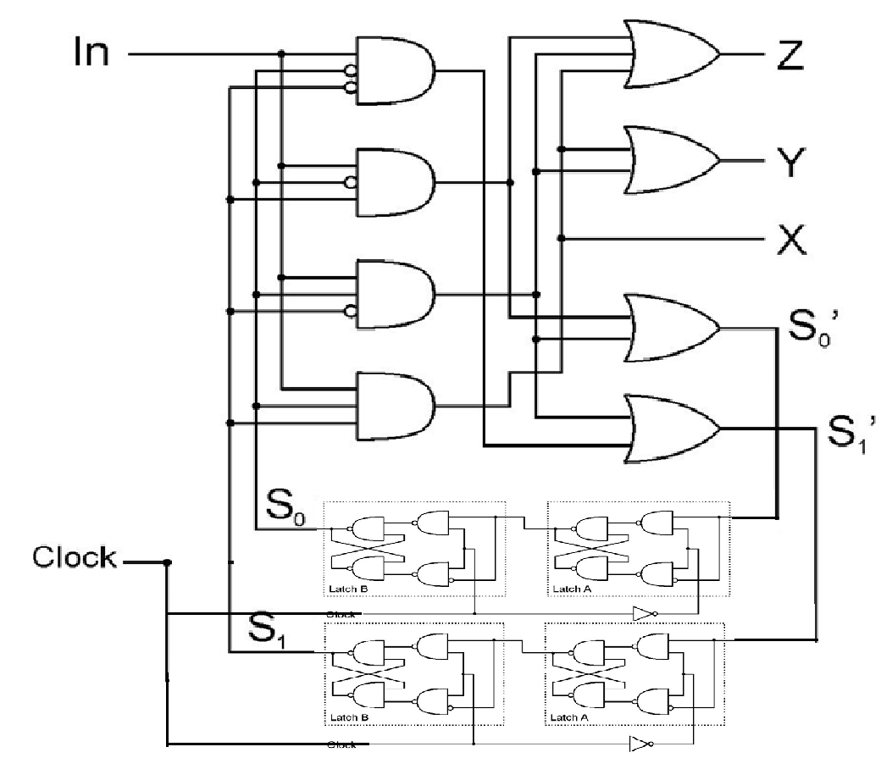
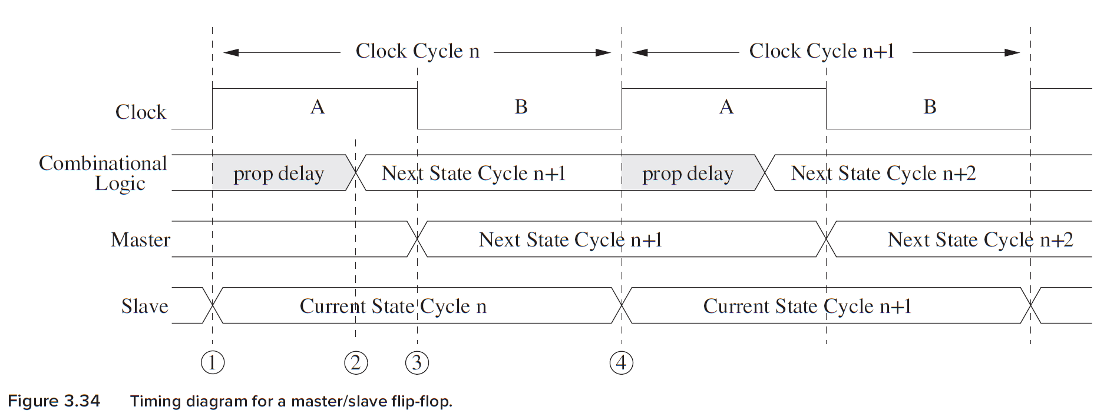
初始状态
In | S₁ | S₀ | S₁’ | S₀’
0 | X | X | 0 | 0
1 | 0 | 0 | 0 | 1
1 | 0 | 1 | 1 | 0
1 | 1 | 0 | 1 | 1
1 | 1 | 1 | 0 | 0
S’1
S’0
S1
S0

Slide 32
Outline
1
Review
2
Sequential Logic Circuits
3
From Logic to Data Path
4
Summary

Slide 33
From Logic to Data Path
The data path of a computer is all the logic used to
process information.
  See the data path of the LC-3 on next slide.
Combinational Logic
  Decoders -- convert instructions into control signals
  Multiplexers -- select inputs and outputs
  ALU (Arithmetic and Logic Unit) -- operations on data
Sequential Logic
  State machine -- coordinate control signals and data movement
  Registers and latches -- storage elements

Slide 34
LC-3 Data Path Overview (Microarchitecture)
₁₆
GatePC
₁₆
GateMARMUX
LD.PC
PC
DR
₃
MARMUX
+1
REG FILE
₁₆
₂
PCMUX
₁₆
₁₆
₁₆
₁₆
₁₆
LD.REG
Control Unit
SR2
OUT
SR1
OUT
[7:0]
Processing Unit
SEXT
₊
SR2
₃
₃
SR1
ADDR2MUX
MUX
MUX
ADDR1MUX
₁₆
₁₆
[10:0]
₁₆
₁₆
₁₆
₁₆
₁₆
SEXT
[8:0]
LD.CC
₁₆
SEXT
FINITE STATE MACHINE
SR2MUX
[5:0]
SEXT
₁₆
N
Z
P
ALUK
_{A}
_{B}
[4:0]
SEXT
₂
ALU
LD.IR
IR
LOGIC
…
₁₆
₁₆
₁₆
RUN
GateALU
₁₆
GateMDR
₁₆
Memory Unit
LD.MDR
MDR
MEMORY
MAR
LD.MAR
₁₆
INPUT
OUTPUT
MIO.EN
MUX
₁₆
MEM.EN,R,W

Slide 35
Outline
1
Review
2
Sequential Logic Circuits
3
From Logic to Data Path
4
Summary

Slide 36
Summary
MOS transistors are used as switches to implement
logic functions.
  N-type: connect to GND, turn on (with 1) to pull down to 0
  P-type: connect to +2.9V, turn on (with 0) to pull up to 1
Basic gates: NOT, NOR, NAND
  Logic functions are usually expressed with AND, OR, and NOT
Properties of logic gates
  Completeness
    can implement any truth table with AND, OR, NOT
  DeMorgan's Law
    convert AND to OR by inverting inputs and output

Slide 37
Summary
We’ve touched on basic digital logic
  Transistors
  Gates
  Storage (latches, flip-flops, memory)
  State machines
Built some simple circuits
  adder, subtracter, adder/subtracter，Incrementer
  Counter (consisting of register and incrementer)
  Programmable traffic sign state machine
Up next: a computer as a (simple?) state machine

Slide 38
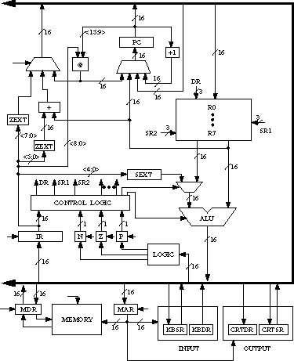
LC-3 Data Path

Slide 39
Next Time
Topic
  The von Neumann Model
Readings
  Chapter 4.0 - 4.2

